Slide 1
Review top-3 Challenge 2020 papers for Challenge 2021
李晓宇
3.25

Slide 2
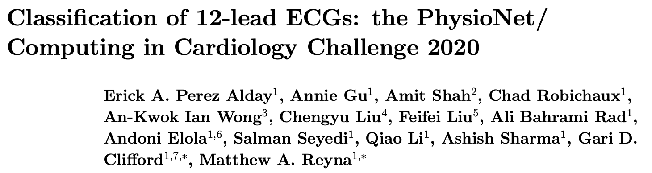
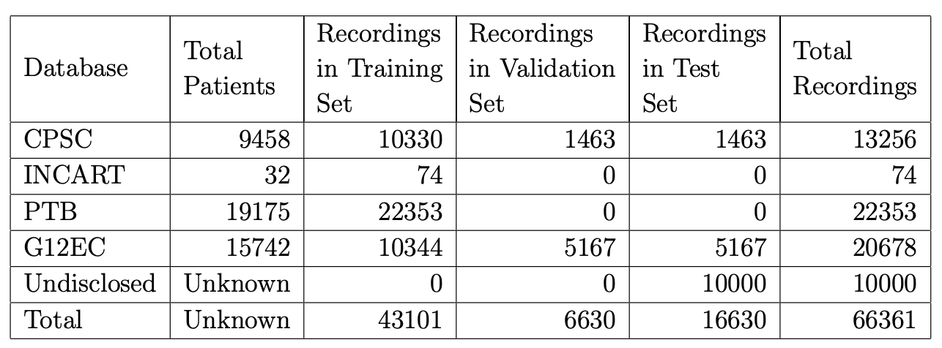

Slide 3
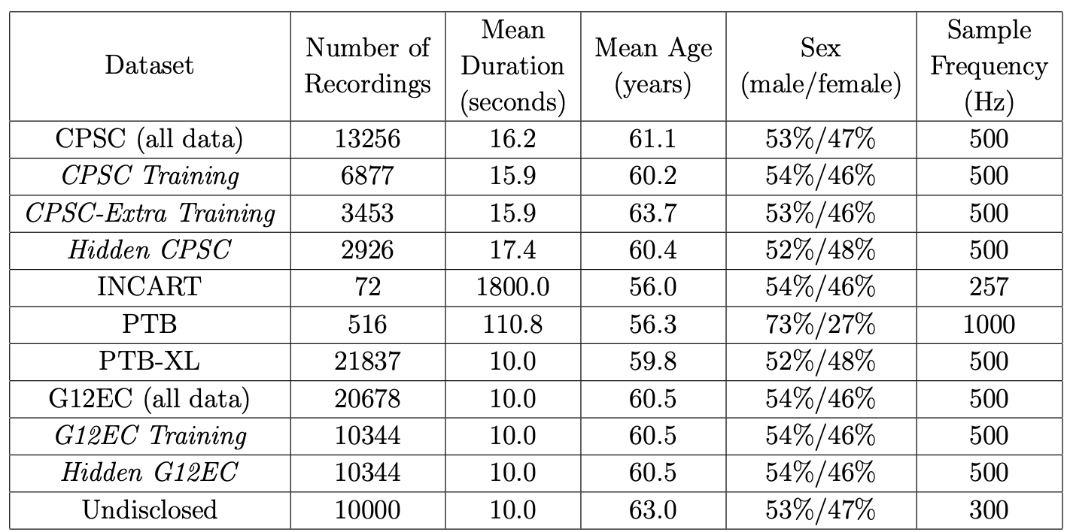

Slide 4
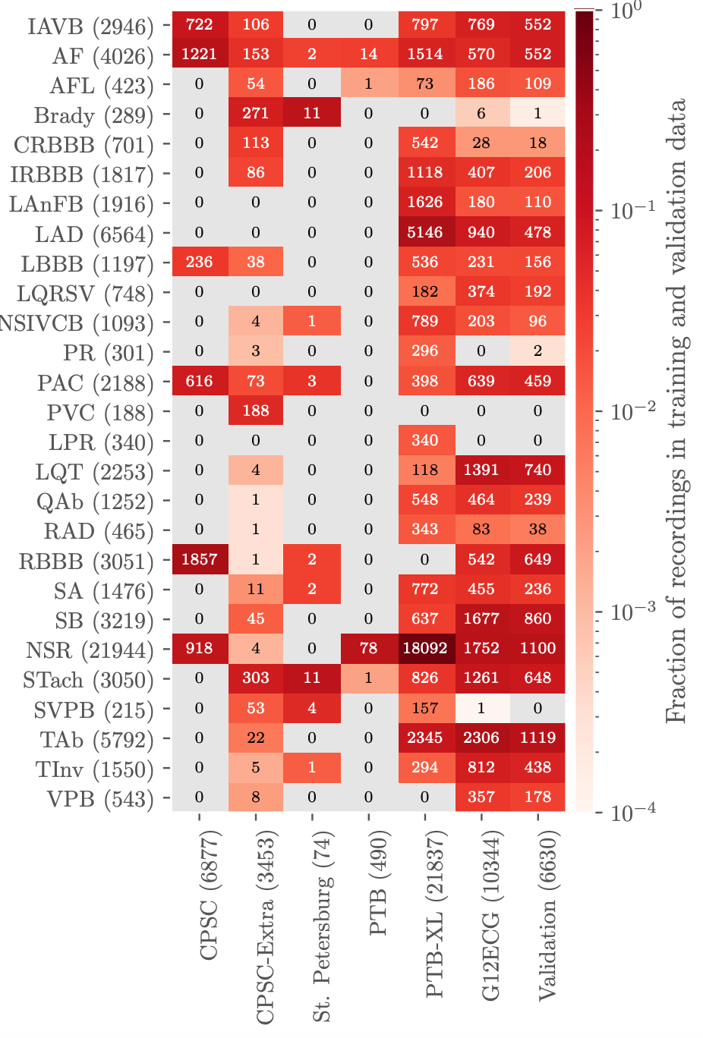
We are creating a large database of heterogeneous data with varying labels, some of which are wrong or incomplete. Leads can be inverted, noisy, mislabeled. We have deliberately made no attempt to clean this up. The test data contains better labels, but it is not perfect either, and although it roughly correspond to the training data, it includes some deliberate differences.

Slide 5
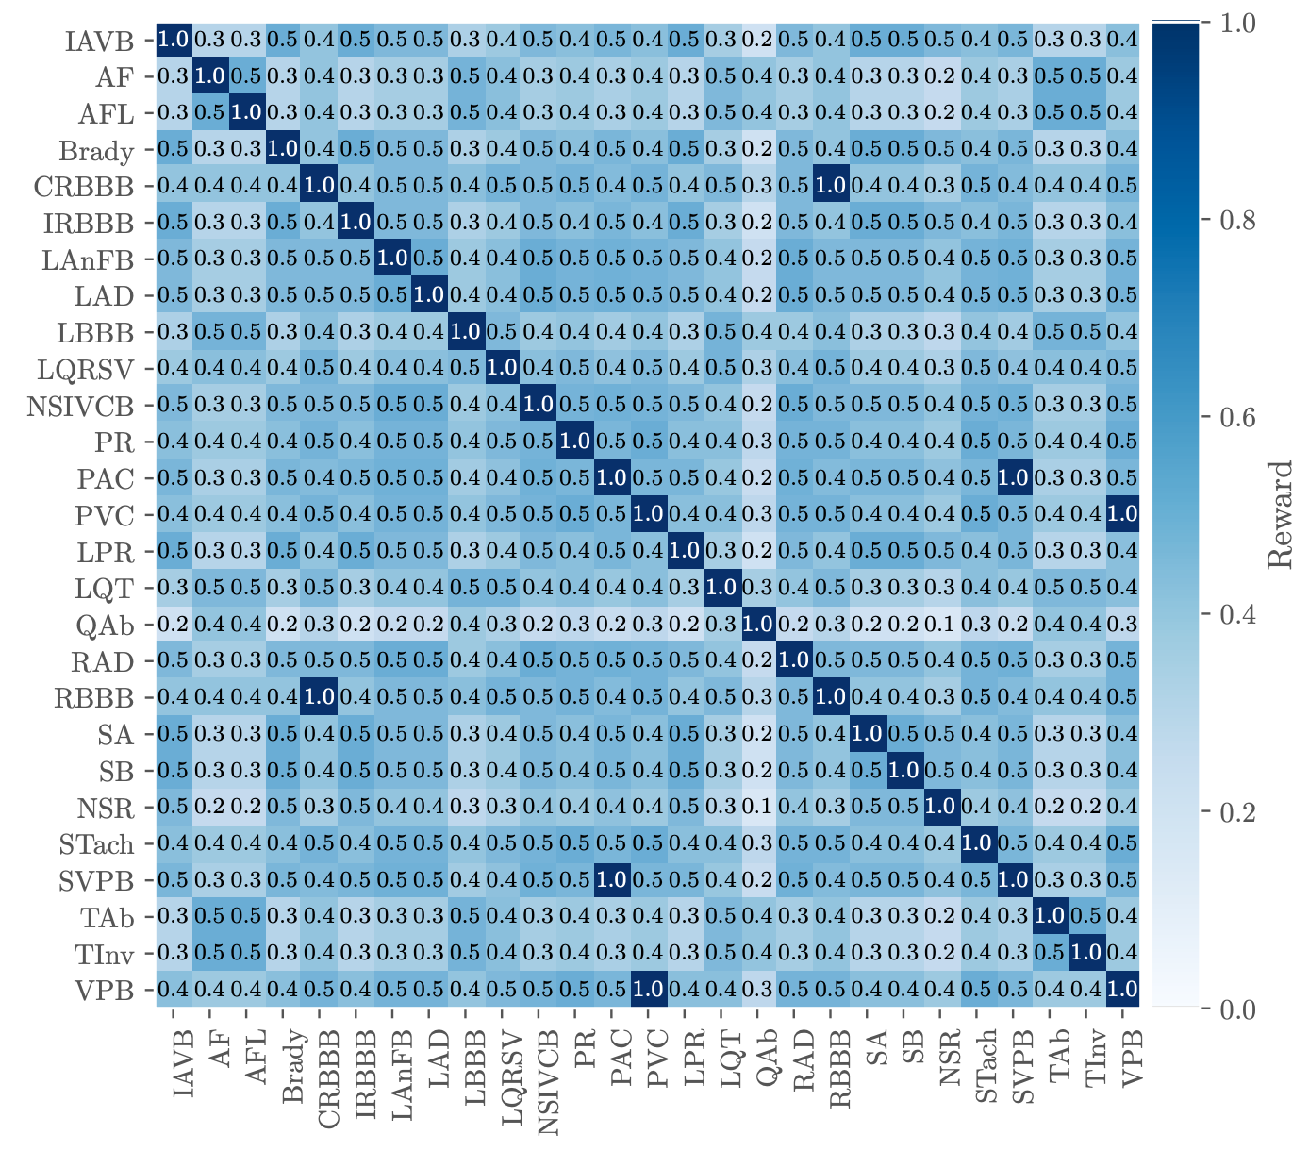
Reward Matrix

Slide 6
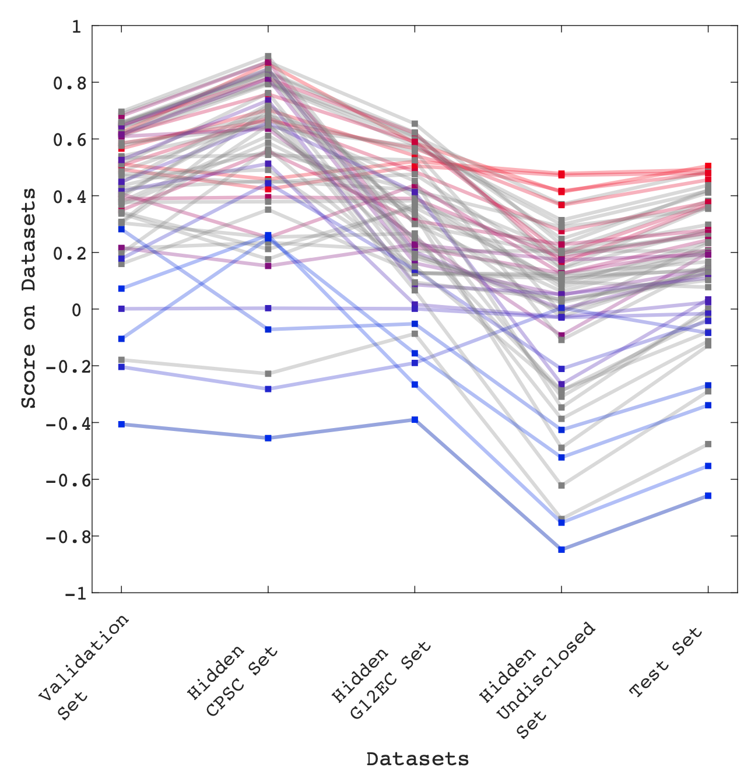
Results

Slide 7
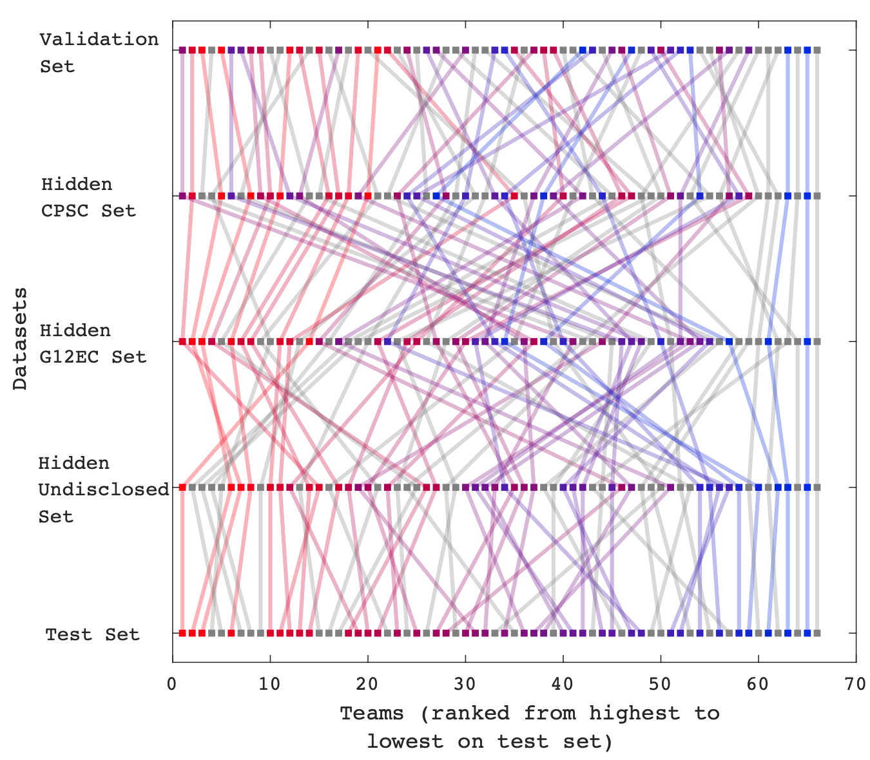
Results

Slide 8
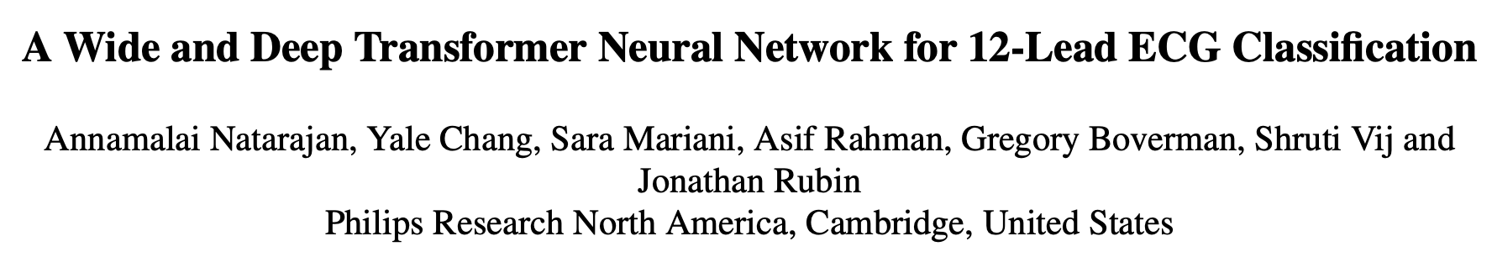
Top-3 teams

Slide 9
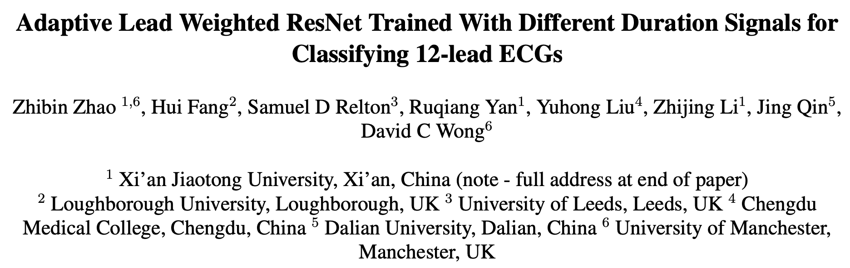
Top-3 teams

Slide 10
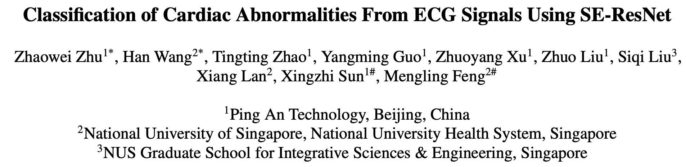
Top-3 teams

Slide 11
Preprocess
1st：
500Hz，FIR bandpass filter 3-45Hz，T=15s，normalized to -1 ～ 1
2nd：
257Hz，4096points（～16s）
3rd：
500Hz, 30s (baseline) & 10s， biorthogonal wavelet transformation for wavelet denoising. INCART dataset is excluded.
8 leads. Data split: 8:2. A external dataset is used for validation. Data without a label in the 27 classes are excluded

Slide 12
Augmentation
None

Slide 13
Knowledge incorporation
1st：
Extract over 300 features from lead II, and select 20 features with random forest. The “wide feature” consists of the 20 features + age + gender.
2nd：
Age and gender as feature
3rd：
No age and gender. Rule-based bradycardia classifier.
Propose abnormal heartbeats segmentation via 1-D U-net. (“Some of the cardiac abnormalities are associated with individual heartbeats”)

Slide 14
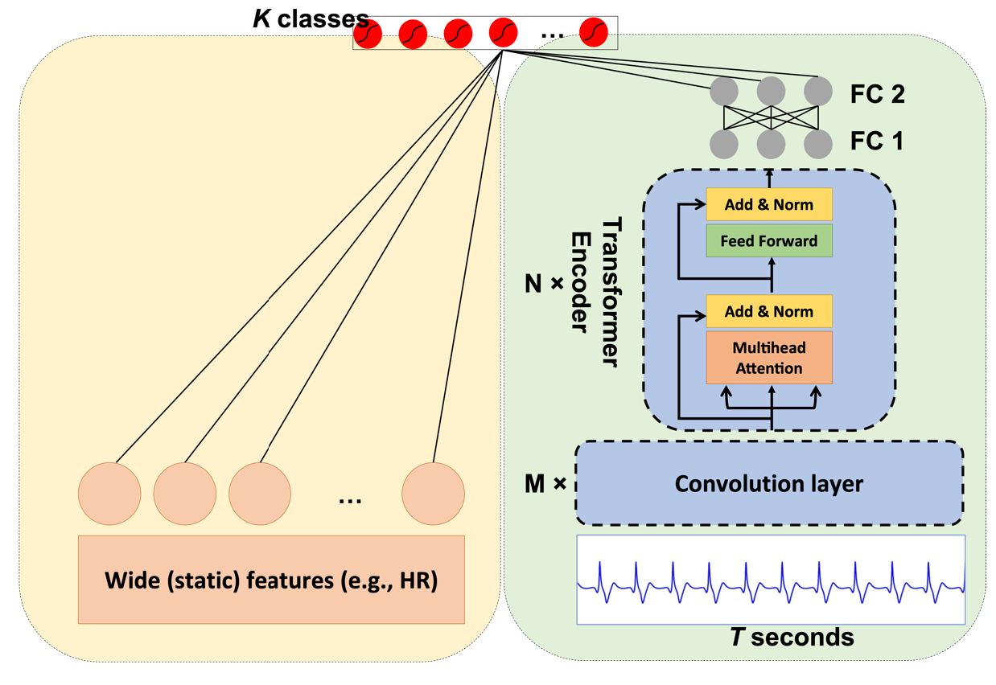
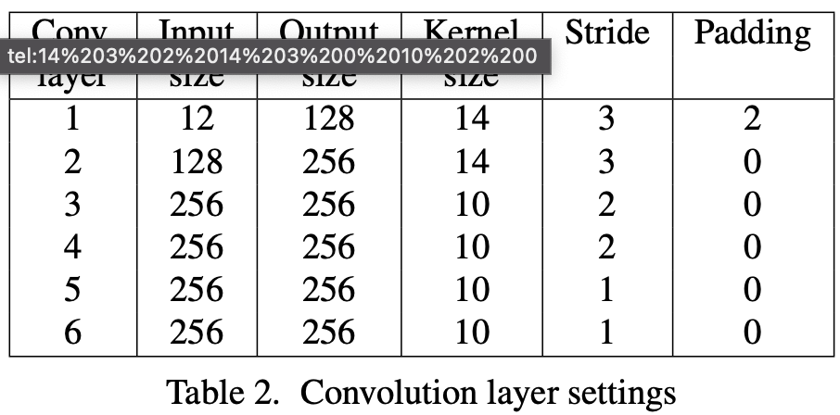
Network 1st
N=8, M=6
FC1: (2046, 64)
FC2: (64+22, 27)

Slide 15
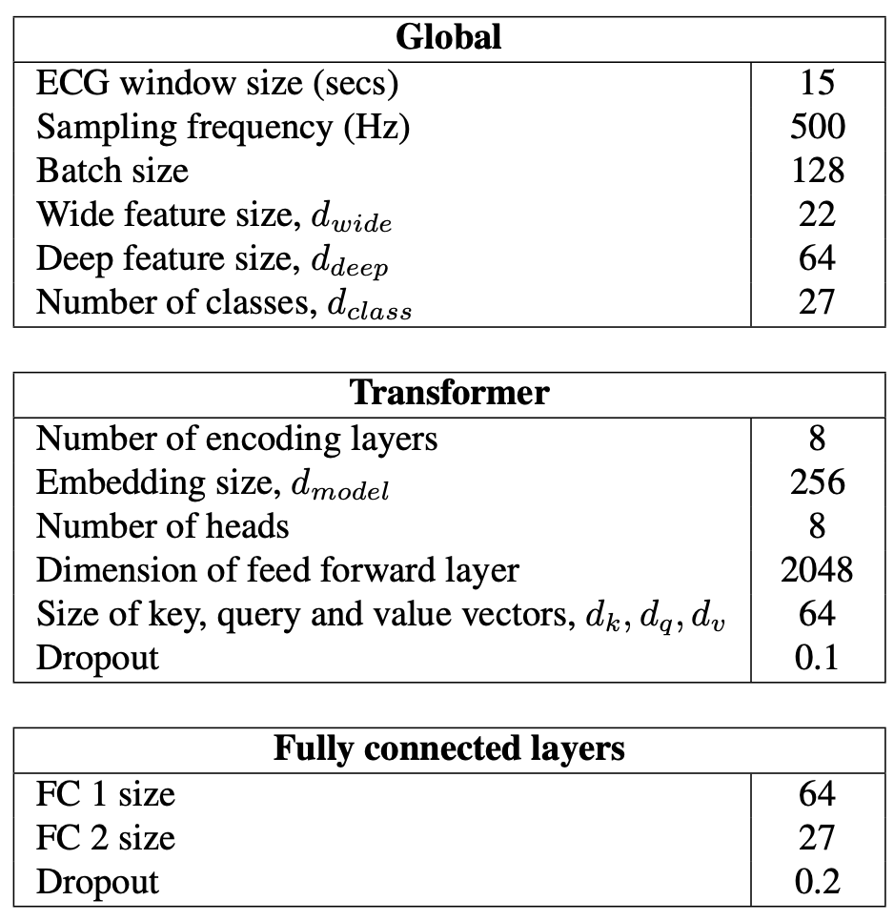
Network 1st
Transformer module did not necessarily lead to better performance than an RNN module, but it did allow for faster model training and iteration.

Slide 16
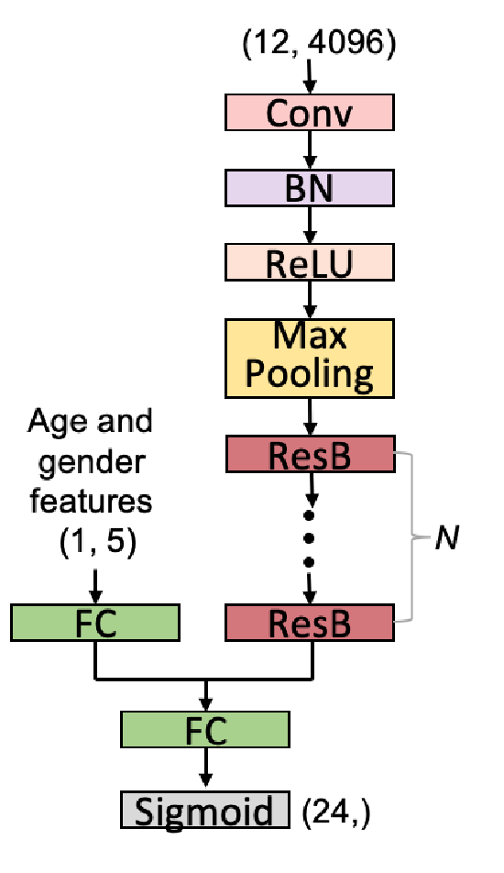
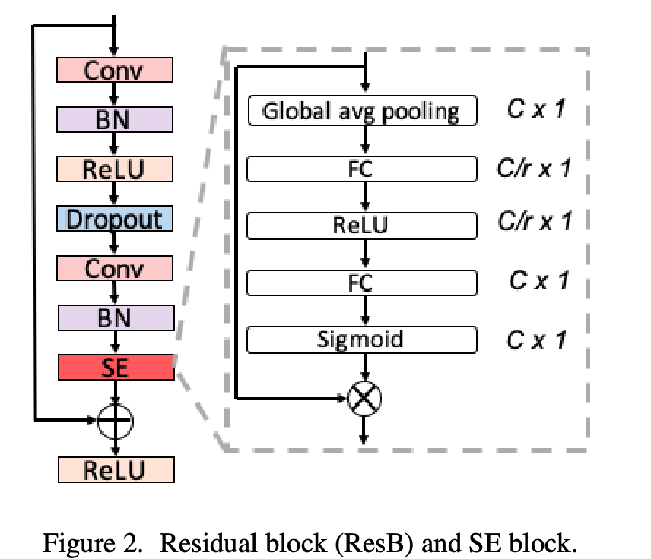
Network 2nd
Age & gender
First kernel 15, other kernels 7
Dropout 0.2
SE block

Slide 17
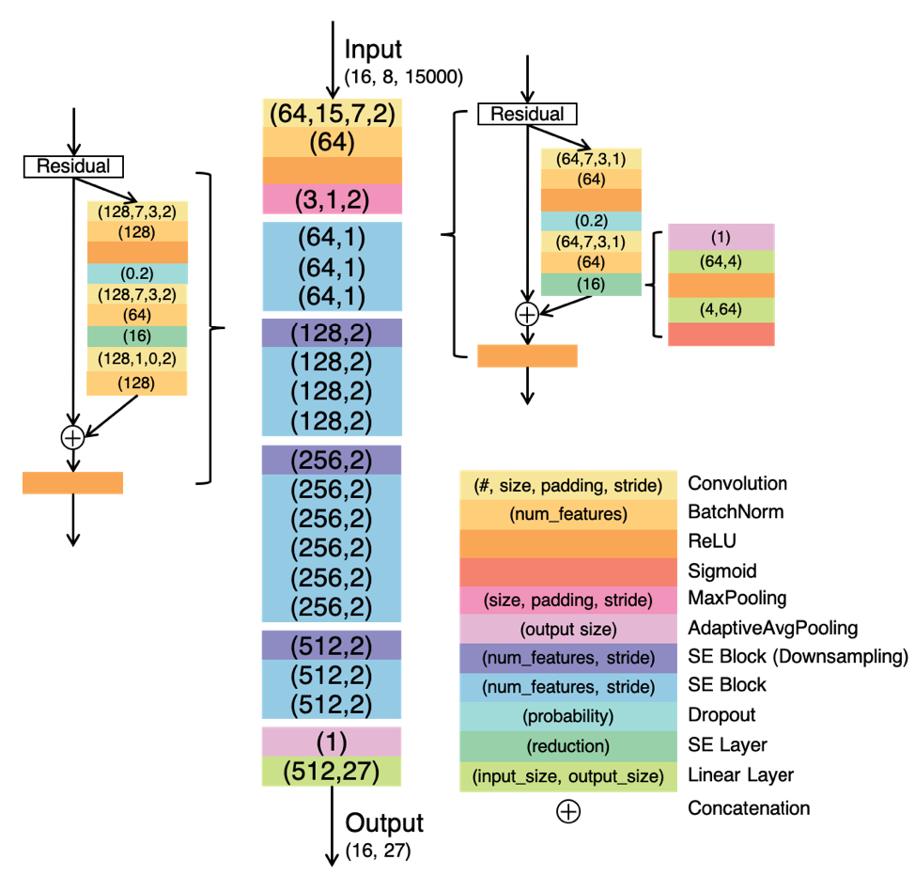
Network 3nd

Slide 18
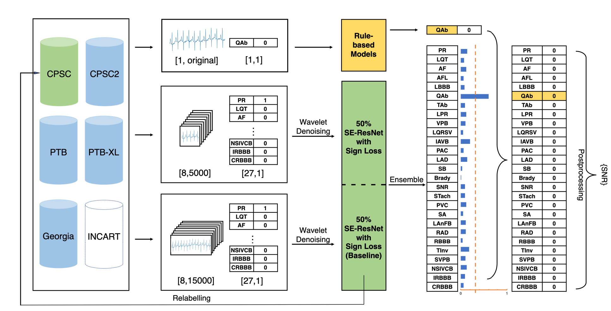
Network 3nd

Slide 19
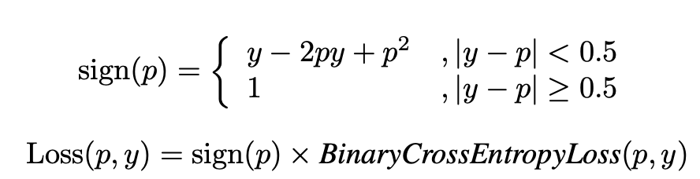
Class imbalance
1st: Optimal thresholds were computed on the model’s validation set to maximize the challenge metric.
2nd: Threshold optimization. “a simple constrained grid-search method”. Accurate representation is possible even in the presence of class imbalance.
3rd: Relabel CPSC data (To train a classifier and label when p>0.8). “The optimal binarization threshold was found to be 0.36 on the offline test set”. Sign loss:

Slide 20
Ensemble
1st: 10 fold cross validation and top-3 models selected. A class is predicted to be positive if any classifier predicts that class to be positive.
2nd: 5 models trained via 5-fold cross validation. ECGs were classified according to the majority vote.
3rd: Model₅₀₀₀ + Model₁₅₀₀₀ + Rule

Slide 21
Others
1st: Noam optimization procedure was observed to be crucial for achieving a reasonable challenge score when using the Transformer module. Future work: to utilize the other 88 classes.
2nd: The improved ResNet failed to migrate from multiple data sets to a completely different data set effectively. Not explainable. Future work: to improve performance by first conducting cluster analysis of false classifications to determine common modes of failure.
3rd: A very high recall and low precision were observed when applying the rule, and this could be attributed to the sub-optimal label quality.

